Slide 1
ETIP PRESE-NTATION
Cyber-threat intelligence (CTI) and OSINT 3

Slide 2
Table of contents
01
02
03
Context and overview of ETIP
Architecture of ETIP
Architectural details
04
DEMO

Slide 3
TEAM MEMBERS
LÊ VIẾT TÀI MẪN - 20521593
VŨ HOÀNG THẠCH THIẾT - 20521957
HOÀNG THANH LÂM – 20521513
PHẠM VĂN XUÂN - 20522184

Slide 4
01
Context and overview of ETIP

Slide 5
Close look of ETIP
Contexts:
OSINT (Open Source Intelligence) data is security data collected from available open sources.
TIPs (Threat Intelligence Platforms). These platforms help companies gather, link, and analyze security data from a variety of sources to help build defenses.
Problem:
Unstructured data from multiple natural sources. TIPs require data to be filtered and processed before being analyzed and shared.
Propose:
ETIP architectures secure data collected from multiple sources and links the data.
Thereby diversifying security data, building a defense system.

Slide 6
Close look of ETIP
Overview
Main content of EITP
ETIP extends the ability to import and share information of internal detection and monitoring systems.
A solution to improve the quality assessment of security data.
A process of linking related security data from multiple internal detection sources and monitoring systems.
Calculate threat score for each Indicator of Compromised (IoC)
Deploy the platform
ETIP (Enriched Threat Intelligence Platform) Architecture
Security data is leveraged from OSINT and collected from various sources such as firewalls, IDS, IPS, etc. data is linked, evaluated and presented as a threat score.
This information is analyzed to build defense mechanisms.

Slide 7
02
Architecture of ETIP

Slide 8
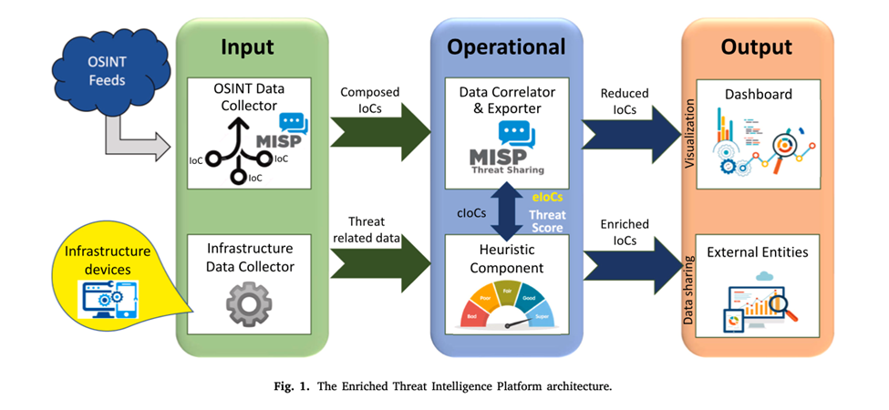
Three modules
I. Input module
III. Output module
II. Operational module
Collect security events (OSINT feeds and infrastructure data), output IoCs and threat data
Data from OSINT and threat data are collated and evaluated
Data from OSINT and threat data are collated and evaluated

Slide 9
03
Architectural details

Slide 10
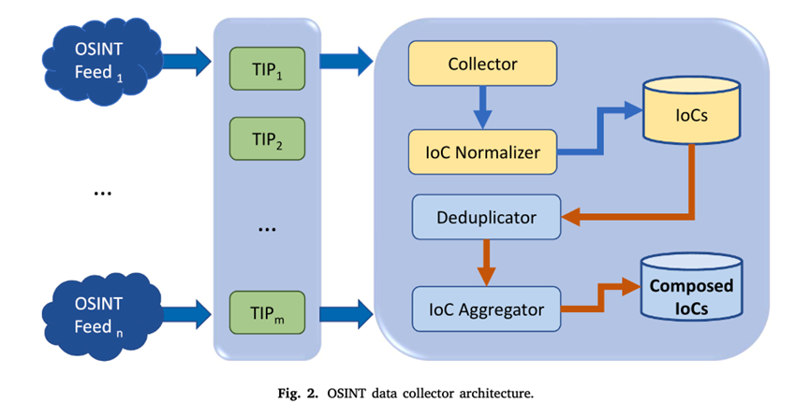
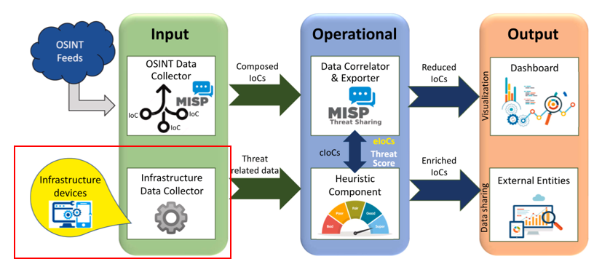
There are 2 types of input module
OSINT data collector
Infrastructure data collector
OSINT Feeds: This component is configured from multiple OSINT sources for security events (cyber-attacks, malware domains, vulnerability exploitation, IP blacklist)
TIPs: Different TIPs collect different OSINT sources, increasing variety.
Collector: Output of various TIPs, as an IOC
IOC normalizer: IOC components are collected with many different formats and returned to one format, stored in a database.
Deduplicator: Since the IOCs can be the same, it is possible to deduplicate.
IoC Aggregator: Integrating IoC together to form a new IoC (new composed IoC)
Collect data from system log such as hashes, signatures, Ips, domains, URLs). Can be obtained from sources such as (event logs, system logs, server logs, Web logs, application logs from firewall, ids, honeypots, security sensor)

Slide 11
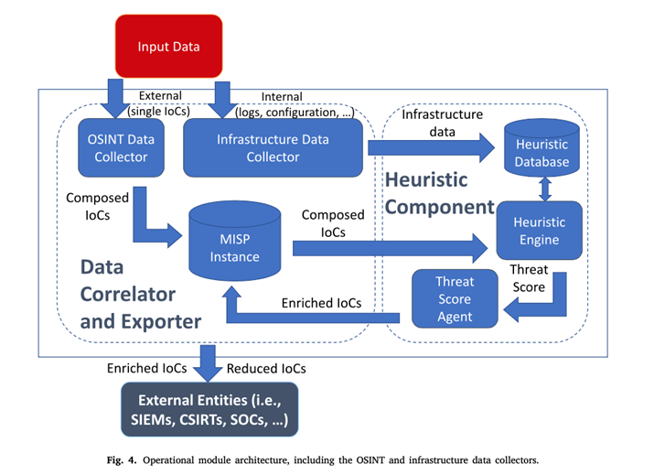
About operation module
This module is based on MISP, which has the function of linking information together.
Consists of 2 main ingredients:
Data correlator & Exporter: is an instance of MIPs, has the function of linking information together.
Heuristic component: perform heuristic analysis, for the purpose of calculating Threat Score.

Slide 12
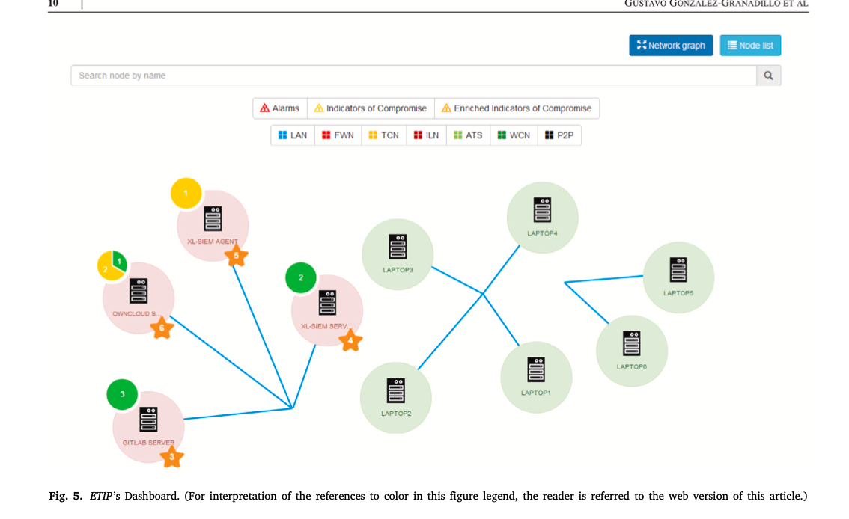
Output module
This module is based on MISP, which has the function of linking information together.
Figure 5 shows the nodes. Nodes include alarm and analog IoC
The alarm section includes the number of issues, IP source and IP destination, and a description of the issue.
The IoC section includes the number of detected vulnerabilities, threat score, vulnerability description, and asso-ciated applications.
The right part of the dashboard contains the nodes of the infrastruct-ure.

Slide 13
Threat Score Evaluation
Source Identification
Heuristic Identification
Threshold definition
Identify the source of information
Identify features from input data.
Defines a threshold level
Score Computation
Training period
Engine Calibration
Assessment for the score computation
Reduce variability
Calculate score
Final test
Check again

Slide 14
04
Demo

Slide 15
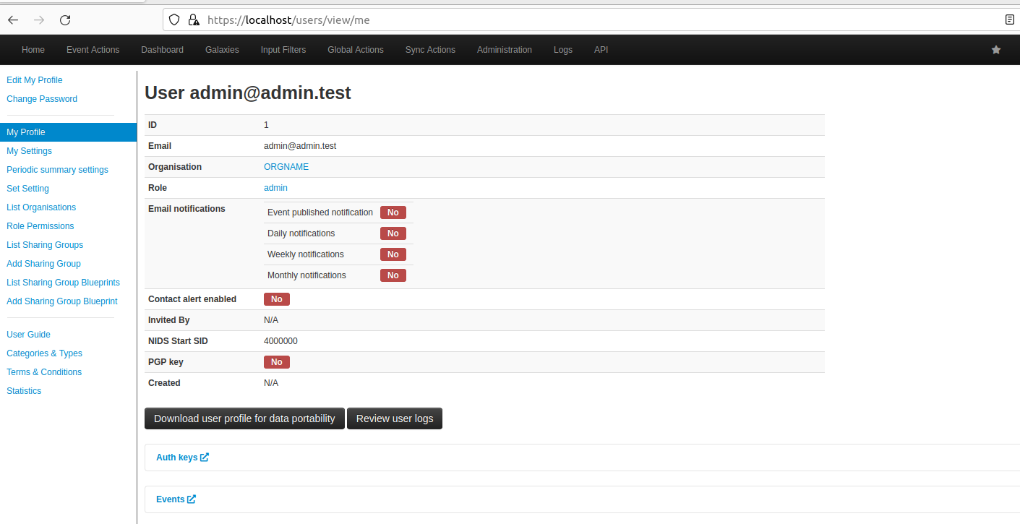
Main Page

Slide 16
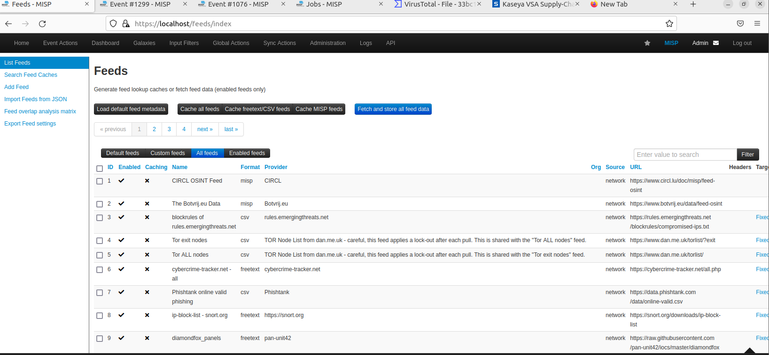
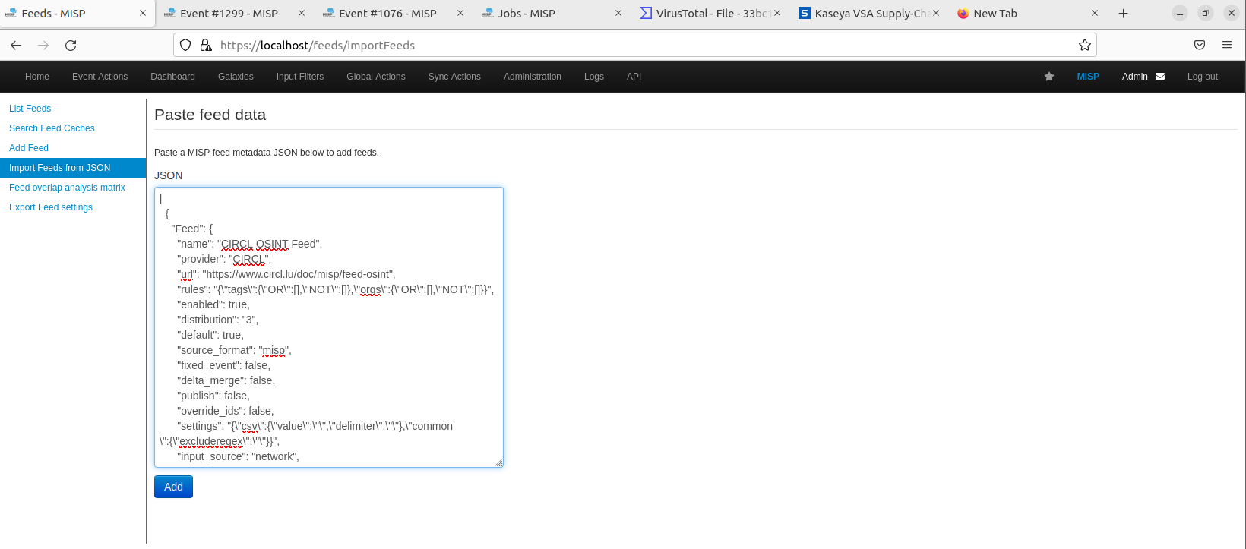
Feeds
Information sources that provide data on threats and cybersecurity metrics
These feeds are typically created and maintained by cybersecurity organizations, security service providers, or the cybersecurity community
Provide information about events, identifiers and information related to threats, including malicious IP, malicious domain, malicious code, attack signature, APT. This information is collected from a variety of sources
We can import feed from a JSON

Slide 17
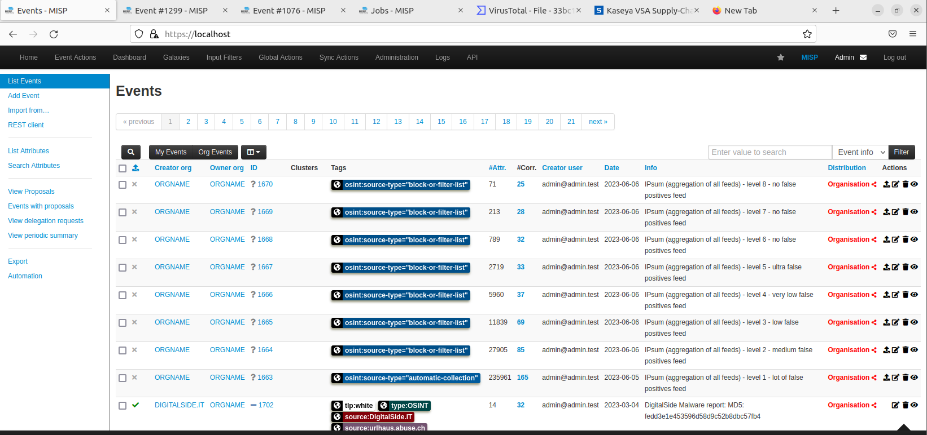
Events
Event contain information related to network security factors and indicators, such as attacks malicious code, attacker information, malicious code sample, attack campaigns,…
Taken from feeds we provided, containing meta data about known ransomware, malware,…
MISP categorizes event for easier analysis
Creator org: Here we can see who is responsible for collecting all that data and putting it in to MISP
Tags: Used to categorize and tag events to enhance search, filtering and sorting

Slide 18
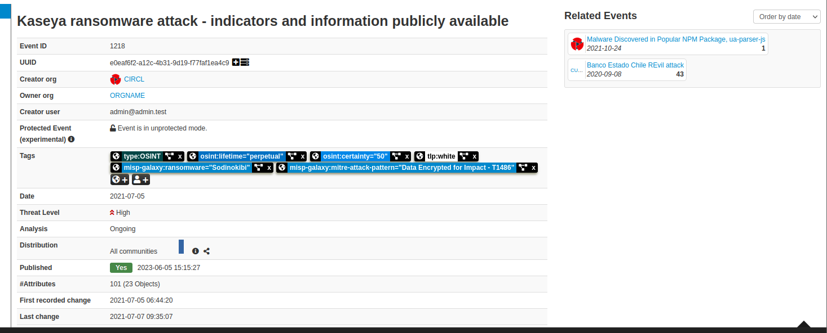
Inside Events
Inside an event we can see more information about it like name of threat, ID, Published day, Threat level, related event, day of attack,…

Slide 19
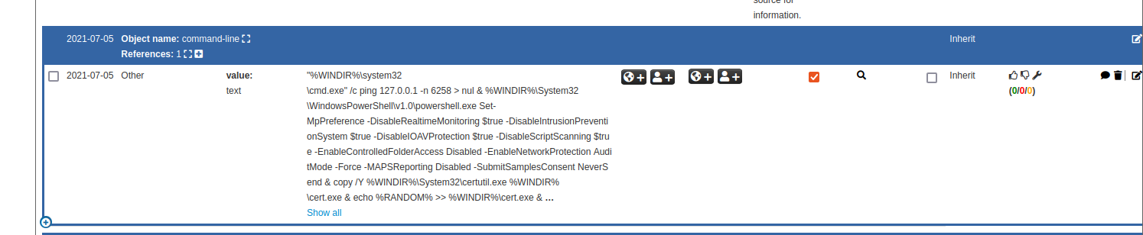
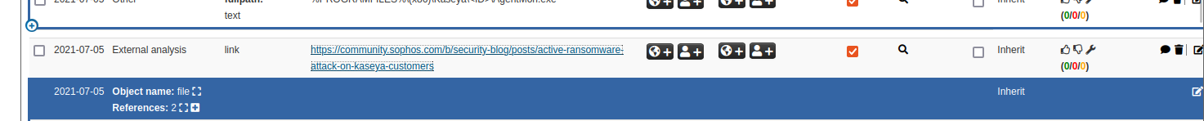
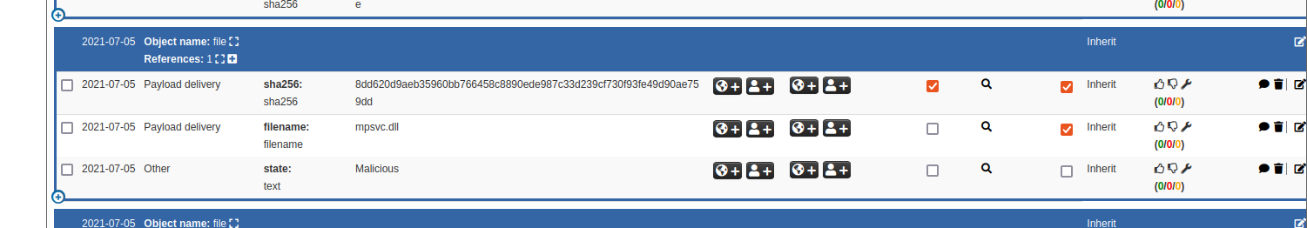
Inside Events
We can know more about the event like:
+ Command-line use in the attack for escalated privileges
+ Direct link to this attack blog. Instead of having google or find relevant information, MISP has provided us with all relevant and focused infocused information
+ Name of malicious dll can be also found when analyzing an event in MISP that malware tries to take control of

Slide 20
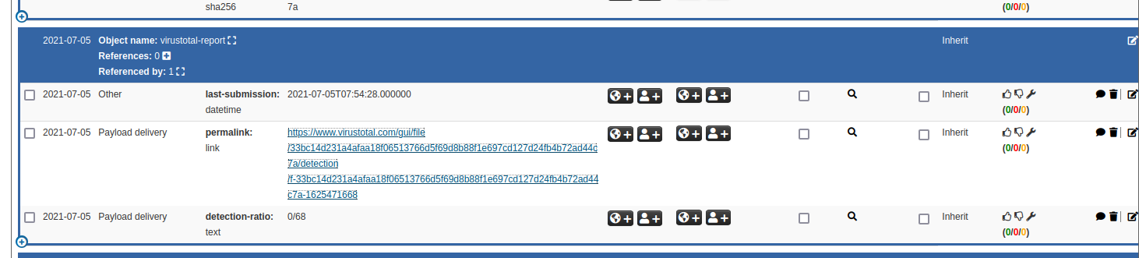
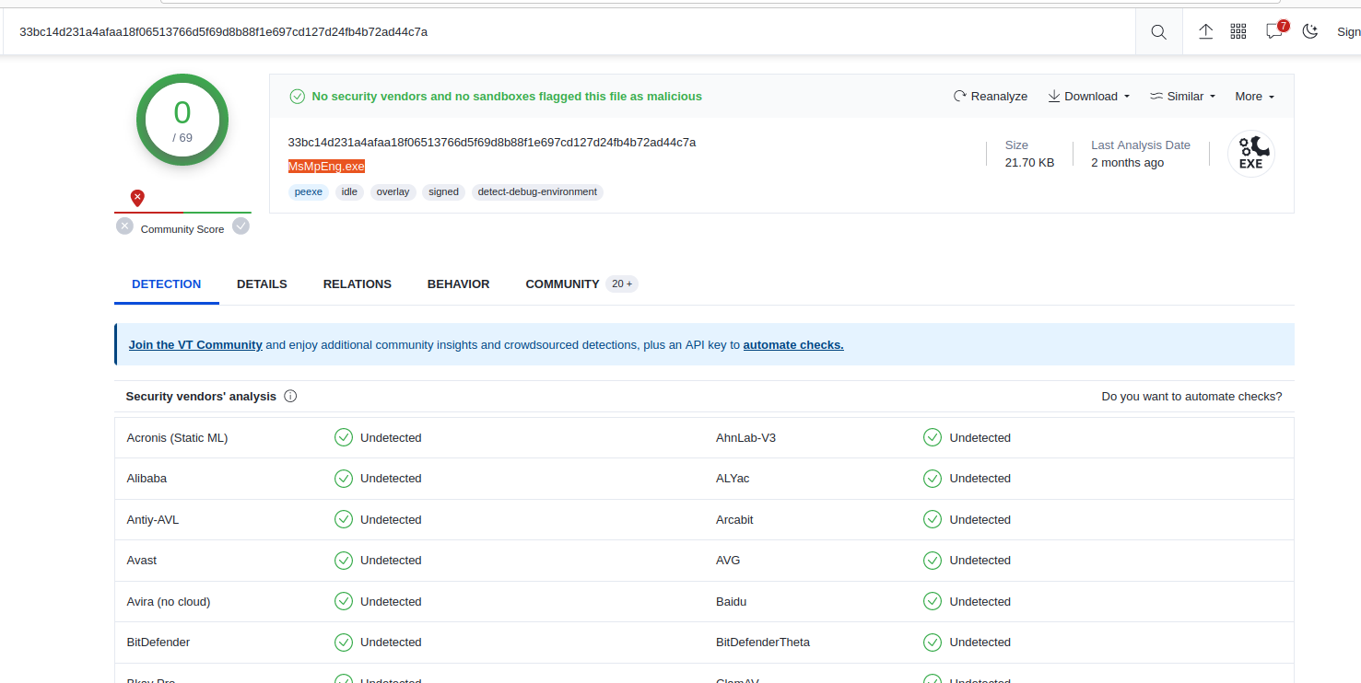
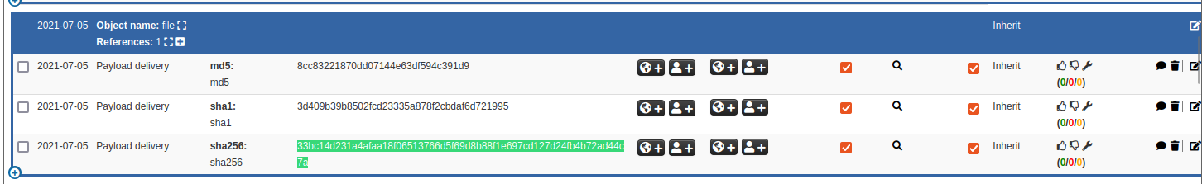
Inside Events
We can know more about the event like:
+ There is a link that takes to the virus total page to see information about the malware
+ If we google or search for normal information that is not structed, we may encounter this situation. But in the IOC hash is in the database of MISP and it related to this ransomware attack

Slide 21
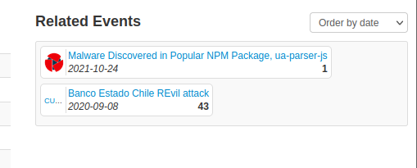
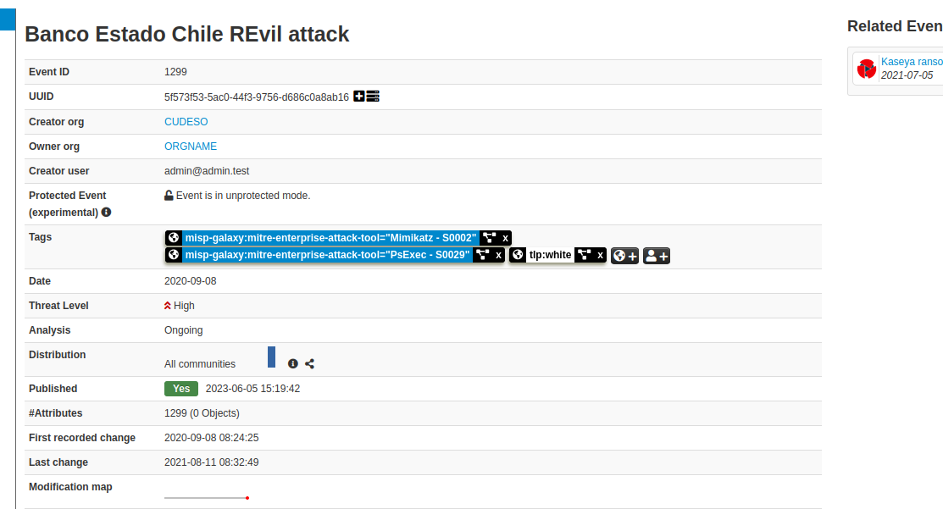
Inside Events
We can see attack event that related to this attack
Maybe this attack event related to another event such as using common malicious domains, common commands, similar payloads,…

Slide 22
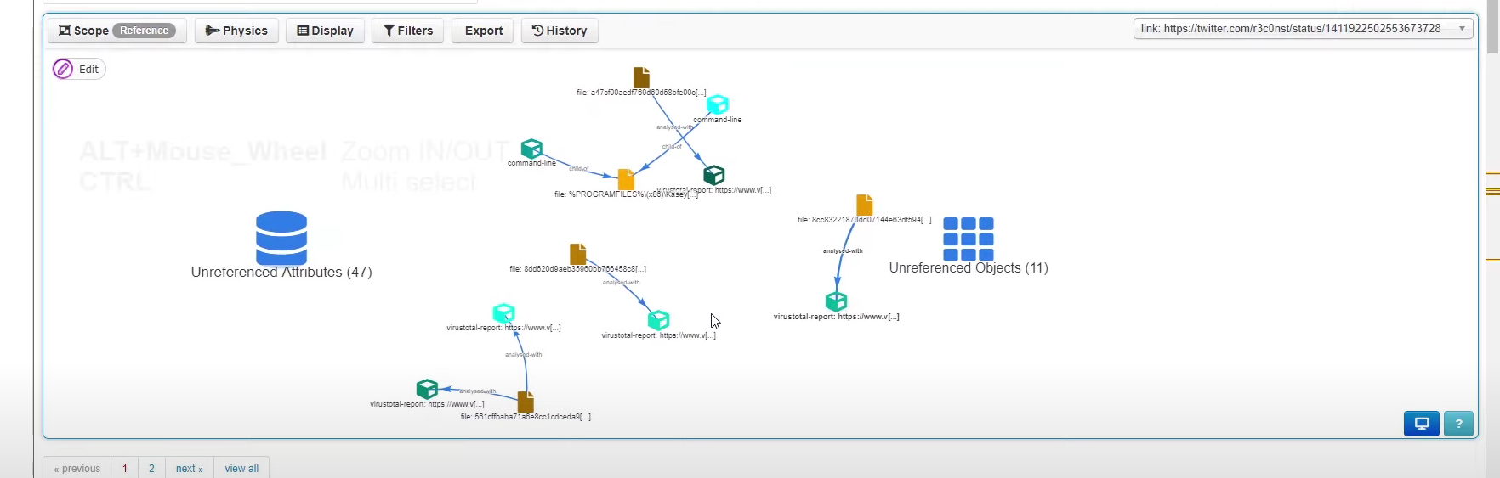
Inside Events
We can see the relationships from the information obtained by the MISP
And all of that we don’t need to do manually, whish is automatically supported by MISP
When dealing with a malware, the sooner it is recognized, the easier is is to detect and prevent it in time

Slide 23
Thanks!
Do you have any questions?
Please contact with thanhlam@gmail.com
All information in and images in the article are referenced from books and mass media

